Slide 1
Linear layer
2021-04-02
4th grade
Jaeho Jeon

Slide 2
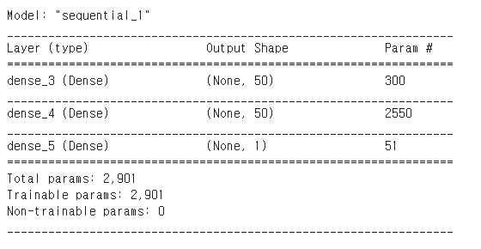
프로젝트 제목
Input size = 5, standardization
Output = 1
1
X
5
input
5
X
50
Dense1
50
X
50
Dense
2
50
X
1
Dense 3
tanh
tanh
1x1
predic
kernel_initializer=‘glolat normal'
bias_initializer='zeros'
activation='tanh'
model.compile(optimizer=sgd_optimizer, loss='mse')
Epoch = 50, lr = 1*e-6

Slide 3
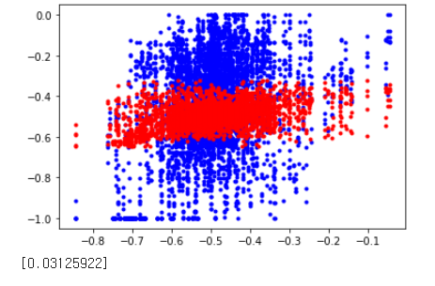
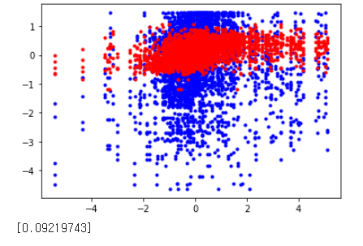
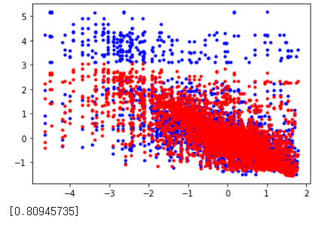
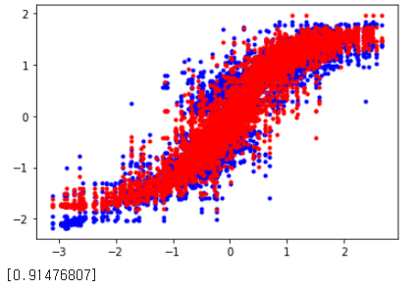
프로젝트 제목
Training 4000 test 1116
Pan_loop
Tilt_loop
train
test
Trans_loop
Rotate_loop

Slide 4
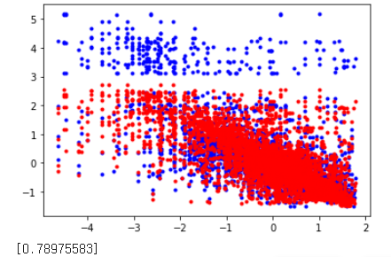
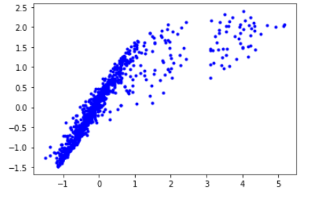
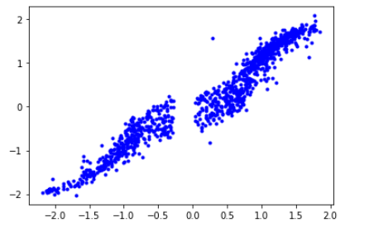
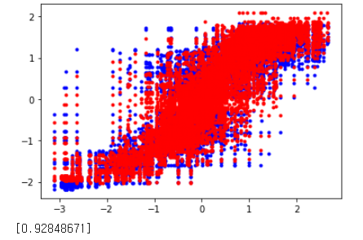
프로젝트 제목
Drop out + boxsize 10
Trans_loop
R-square : 0.8094 ->0.7897
train
TransLoop.m_command
predict
test
Trans_loop offset
real
Rotate_loop
R-square : 0.9147 -> 0.9284
RotateLoop.m_command
predict
rotate_loop offset
real

Slide 5
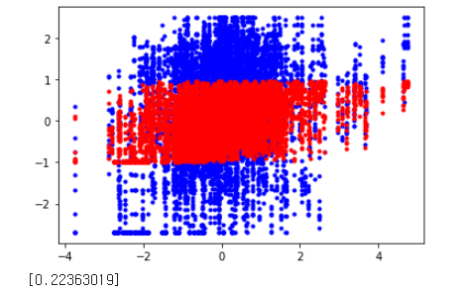
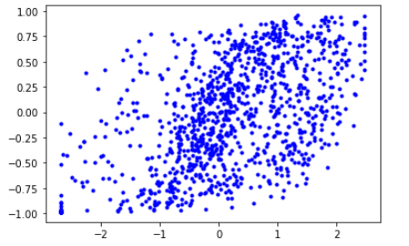
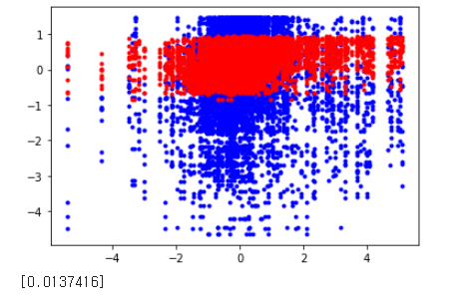
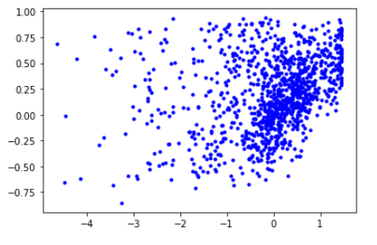
프로젝트 제목
Drop out + boxsize 10
Pan_loop
R-square : 0.0312 -> 0.2236
train
panLoop.m_command
predict
test
Pan_loop offset
real
Tilt_loop
R-square : 0.0921 -> 0.0137
tiltLoop.m_command
predict
tilt_loop offset
real

Slide 6
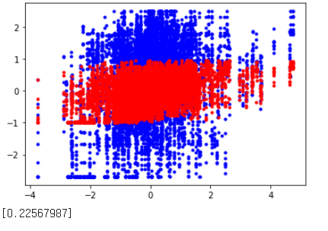
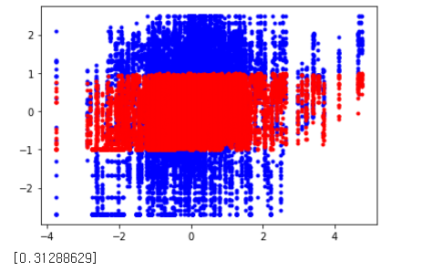
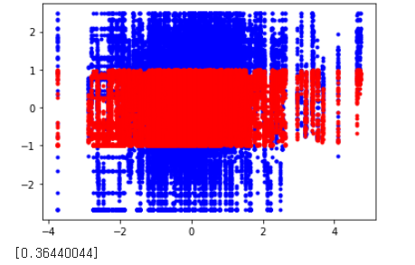
프로젝트 제목
Pan_Loop data
Box size : 5
Box size : 10
Box size : 15
Box size : 20

Slide 7
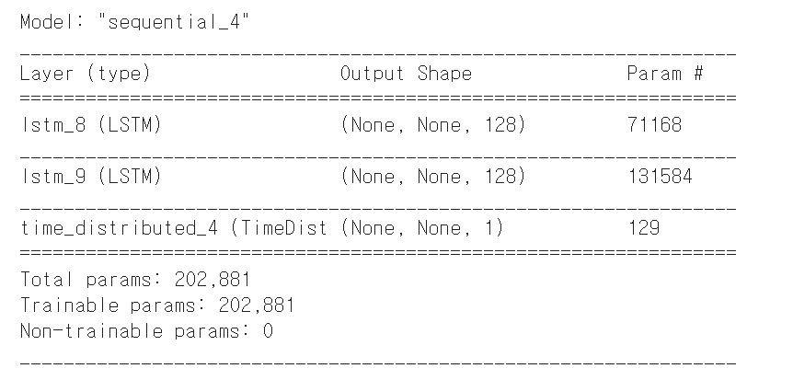
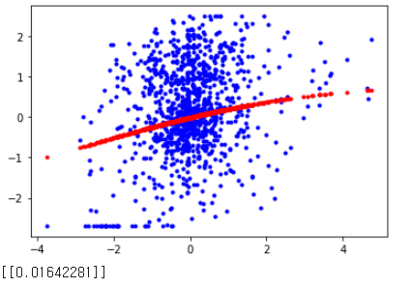
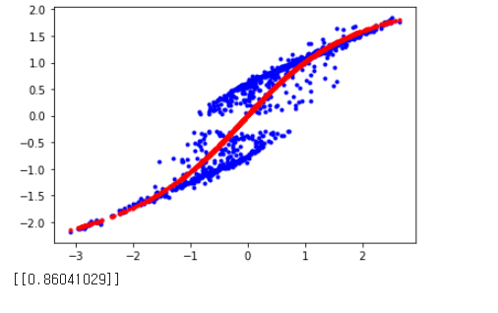
프로젝트 제목
LSTM, Many to many, 2 layer
Pan_loop
train
test
Rotate_loop

